Slide 1






Pcourse
A course evaluation system
Defender：彭巍(Peng Wei) 冼文威(Xian Wenwei)
Major：Computer Science
Teacher：Basker Geroge
Time：2019·1·6
Notes:
版权声明：300套精品模板商业授权，请联系【锐旗设计】:https://9ppt.taobao.com，专业PPT老师为你解决所有PPT问题！

Slide 2






CONTENTS
01
Background
P03
02
Purpose & User
P09
03
Main features
P14
04
Tools & Environment
P19
05
Product present
P24

Slide 3
1
Background
Notes:
版权声明：300套精品模板商业授权，请联系【锐旗设计】:https://9ppt.taobao.com，专业PPT老师为你解决所有PPT问题！

Slide 4
01
Background
When we have to choose lessons and teachers, we will find that I don’t know which teacher is suitable, which lessons I actually want to learn. When we choosing classes, what we can get from the page is the lessons’ name and teachers. It’s not enough to figure out whether this lesson is worthy.
Why we do this
Notes:
版权声明：300套精品模板商业授权，请联系【锐旗设计】:https://9ppt.taobao.com，专业PPT老师为你解决所有PPT问题！

Slide 5


2
Purpose & User
Purpose
User

Slide 6
02
Purpose
AIM
This website is aimed to solve this problem. We will provide a platform which student who have taken these lessons before can markdown them advises and score the lessons and teachers. What’s more, as the runner, we will provide the textbook list and some review file to students.

Slide 7
02
User
Student
This system is built for student who have no idea on what these lessons will teach and whether this lesson’s teacher is good enough or not.
So, SZU students are the main user.
Student
80%
Teacher
After our platform release, we hope our teachers will come to our platform and take students’ evaluation as reference
20%
Teacher
Notes:
版权声明：300套精品模板商业授权，请联系【锐旗设计】:https://9ppt.taobao.com，专业PPT老师为你解决所有PPT问题！

Slide 8


3
System main Features
Courses search
Courses introduction
Courses teacher appraise
Courses textbook
Courses review files
Article sharing
Notes:
版权声明：300套精品模板商业授权，请联系【锐旗设计】:https://9ppt.taobao.com，专业PPT老师为你解决所有PPT问题！

Slide 9
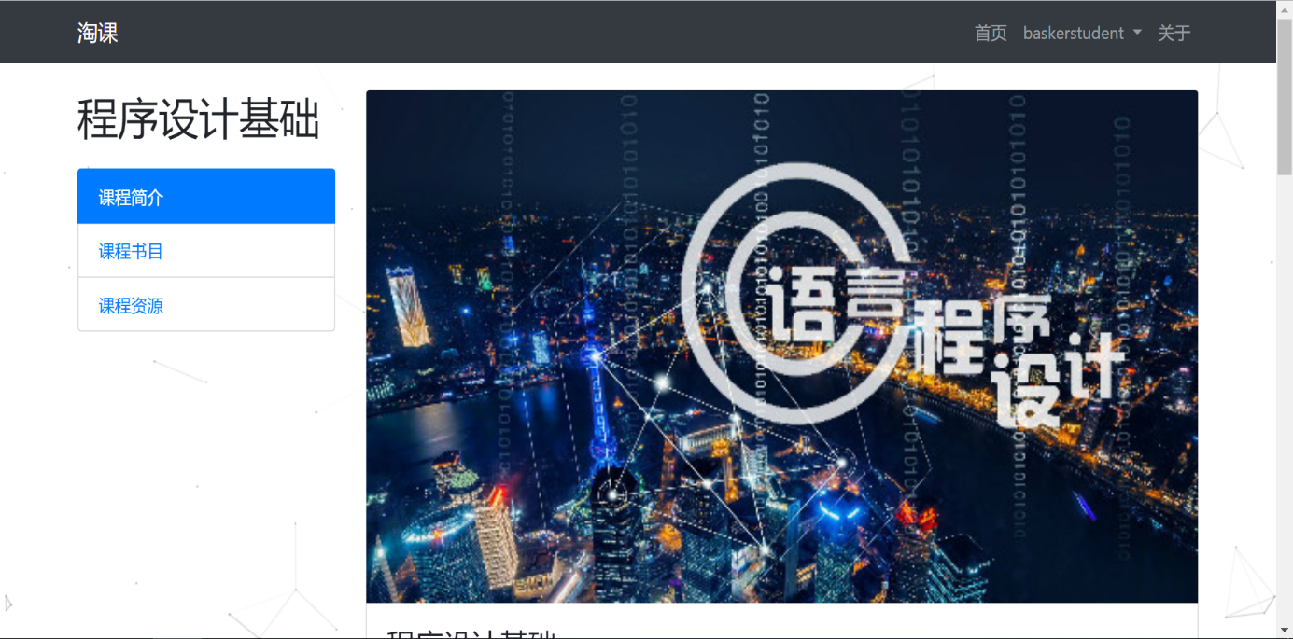
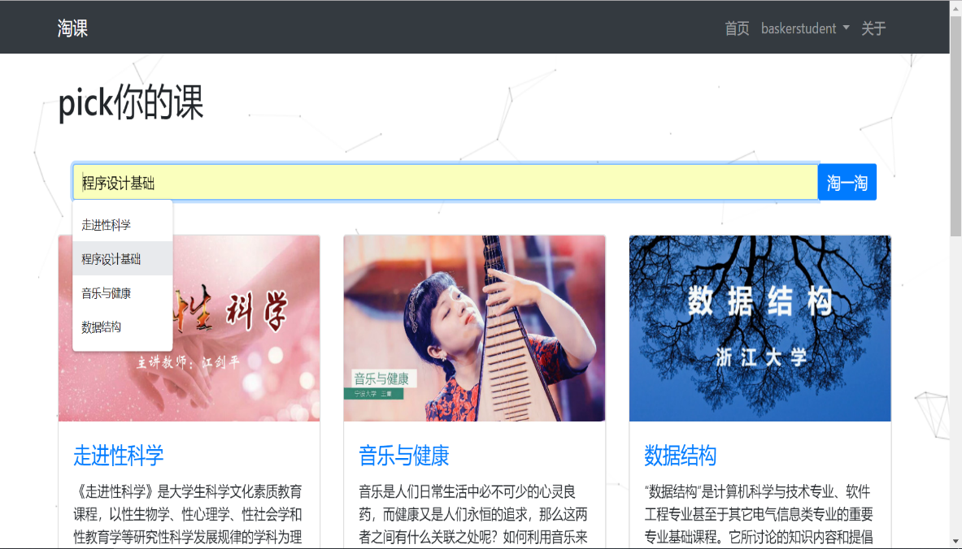
03
System main Features
Courses introduction
Courses search
Student can know about what this course will teach.
Student can search the course freely.

Slide 10
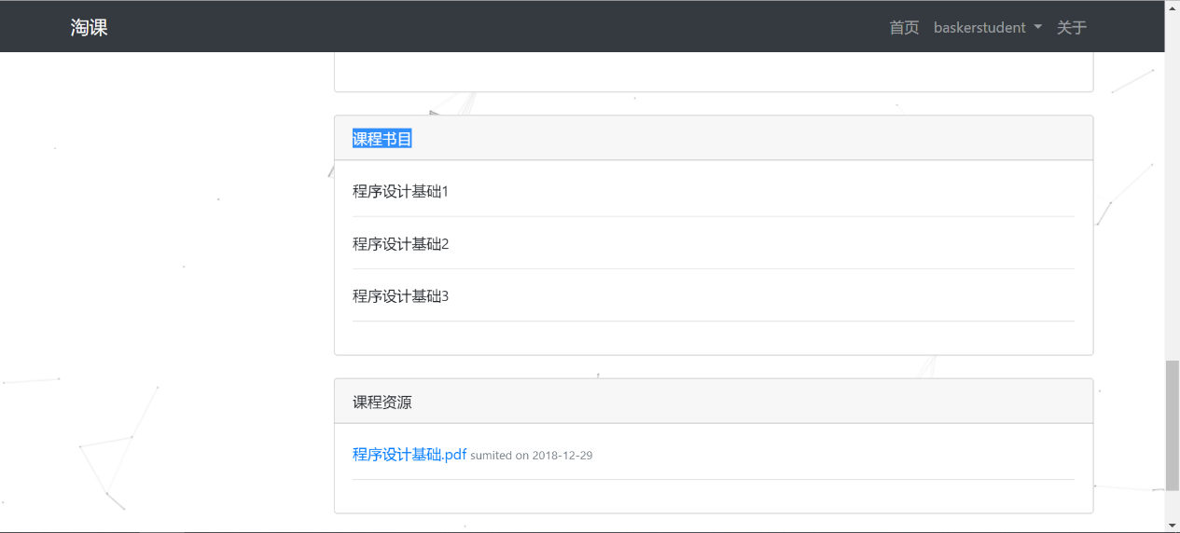
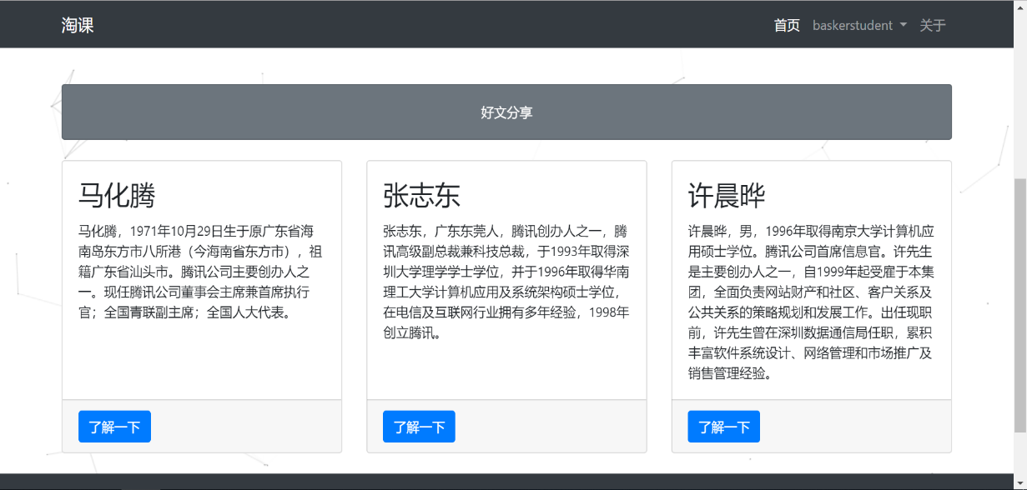
03
System main Features
Course review files & textbooks
Article sharing
The website will provide some documents which include abstract knowledge and examination range.
Student access the website will see some good articles.

Slide 11
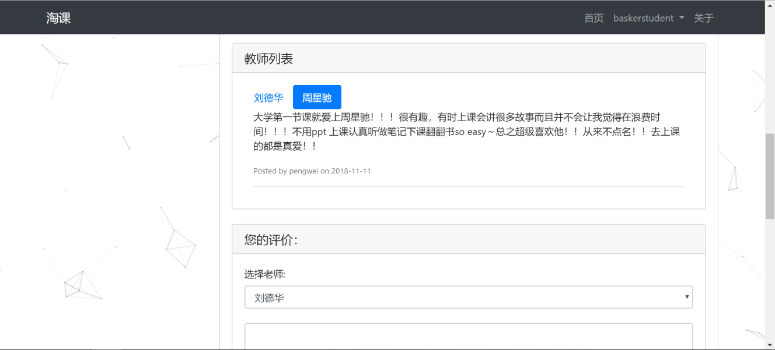
03
System main Features
Courses teacher appraise
Article sharing
Student can know whether the teacher is suitable.
Student access the website will see some good articles.

Slide 12

4
Tools & Environment
Hbuilder
XAMPP
Notes:
版权声明：300套精品模板商业授权，请联系【锐旗设计】:https://9ppt.taobao.com，专业PPT老师为你解决所有PPT问题！

Slide 13

5
Project present

Slide 14
Thank you!
Defender：彭巍(Peng Wei) 冼文威(Xian Wenwei)
Major：Computer Science
Teacher：Basker Geroge
Time：2019·1·6
Notes:
版权声明：300套精品模板商业授权，请联系【锐旗设计】:https://9ppt.taobao.com，专业PPT老师为你解决所有PPT问题！

